Slide 1
Objective vs. Perceived Air-pollution as a Factor of Housing Pricing: A Case Study of the Greater Haifa Metropolitan Area
Boris A. Portnov
Graduate School of Management, University of Haifa, Israel (e-mail: Portnov@nrem.haifa.ac.il)
European Real Estate Society ERES 2010 Conference - Milan, Italy 23rd-26th June 2010

Slide 2
Background (1)
As well known, market prices of residential properties are affected by several environmental factors, including landscape views, noise, vegetation, and air quality;
According to several recent studies, an increase of air pollution by 1 ppb of Ozone (an air pollutant strongly associated with visible smog) tends to decrease real estate values by up to 7% (Beron et al., 2001; Anselin and Losano-Gracia, 2008).

Slide 3
Background (2)
Since clean air is not an explicit market good, for which price can be established directly by market forces, "indirect" methods (such as the Hedonic Price Method) are commonly used to estimate its effect empirically.
These "indirect" methods are based actual transactions and empirical measurements, and assume that decision-makers possess all the necessary information and always act rationally, attempting to maximize their personal utility.

Slide 4
Rationale
However, when, in the process of their location decision-making, apartment buyers weigh one property or location against the other, their choices are not necessarily rational.
Their rationality is essentially "bounded" by available information, limited processing capacity, errors of judgment, and inability to foretell the future.
As a result, real estate decisions are most often made according to personal perceptions of the place and limited information available.

Slide 5
Study goal
The present study examines and compares the real estate price effects of objective (that is, field measured ambient air quality pollution levels) and subjective perceptions of air quality obtained through questionnaires distributed among local residents.

Slide 6
Research objectives:
To determine the strength of the link between “objective” and “subjective” measures of air quality, and
To establish whether the "subjective" measures of ambient air quality perform better in explaining the variation of apartment prices than objectively measured air pollution levels.

Slide 7
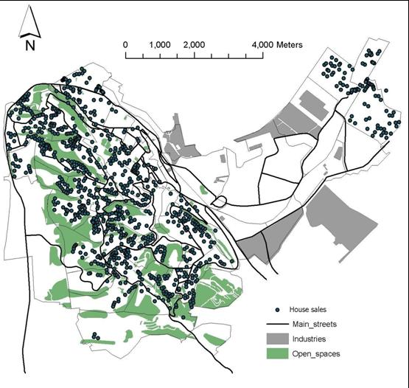
Study area
The City of Haifa and its two suburbs – Kiryat Haim and Kiryat Shmuel (a total of 300,000 residents)

Slide 8
Data sources
Real estate data: A sample of 926 housing units sold in GHMA in 1998-2007 was drawn from the Apartments & Houses’ Sales (AHS) Database, maintained by the Israel Tax Authority, and matched by market transactions maintained by a local real estate appraiser agency;
Residential survey: 200 adult residents of GHMA (aged 20 to 60+) were selected at random and asked to rank air pollution levels in each of the 42 city neighborhoods ona 0-5 scale, from "absolutely unpolluted" (0) to "extremely polluted" (5).

Slide 9
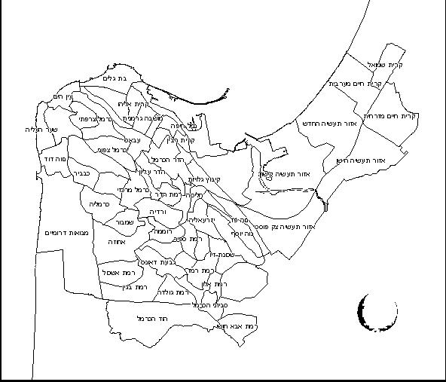
Neighborhood map
Ranking scale:
from "absolutely unpolluted" (0) to "extremely polluted" (5)

Slide 10
Objective air pollution data
Source: 20 air quality monitoring stations for sulfur dioxide (SO₂) and 9 stations that for PM₁₀ (particulate matters with a cut-off diameter of 10 microns).
Processing: Long term observations for 2002-2007, averaged and interpolated by kriging, to obtain continuous pollution surfaces covering the entire study area.
Linking: Individual apartments were juxtaposed over pollution surfaces, and SO₂ and PM₁₀ pollution estimates obtained for the locations of individual apartments using the "spatial join" tool in the ArcGIS9.xTM software.

Slide 11
Analysis phases
Direct comparison between objective and subjective air pollution estimates;
Hedonic regression analysis using subjective and objective air pollution estimates, controlled for property and neighborhood characteristics;
Analysis of spatial dependency of residuals and spatial lag modeling;
Simulation of the effect of air pollution on property prices.

Slide 12
Control variables
Apartment size (m² of the floor area);
Sale year (coded as a set of indicator variables);
Elevation of the apartment above the sea level (used as a proxy for the income level of local residents);
Proximities to parks, industries and main roads (m).

Slide 13
Research results

Slide 14
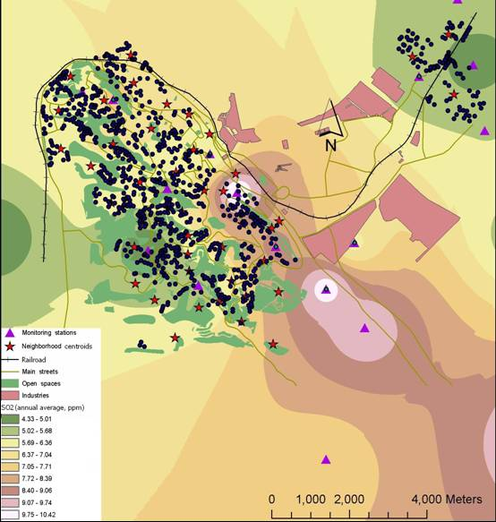
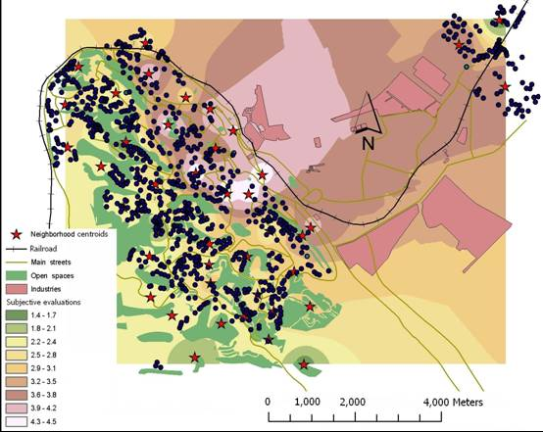
SO2 vs. Subjective estimates
Subjective estimates
SO₂ pollution

Slide 15
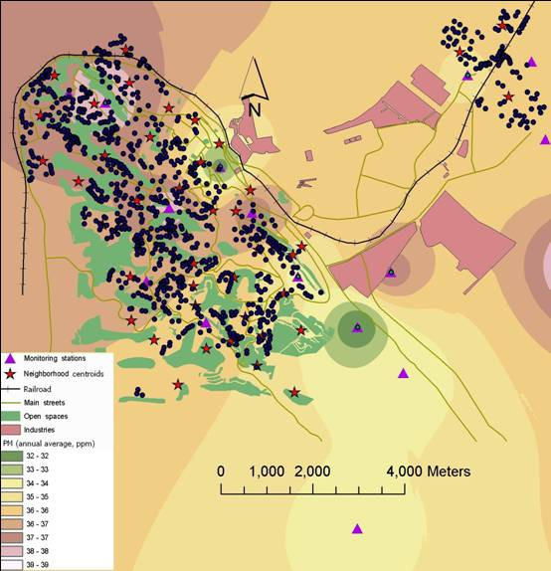
PM₁₀ vs. subjective estimates
Subjective estimates
PM₁₀ air pollution

Slide 16
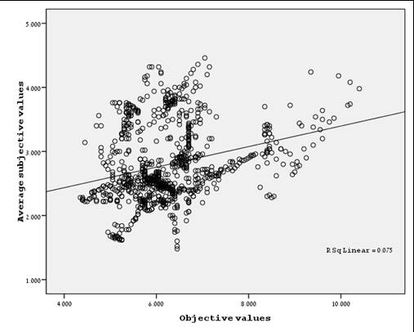
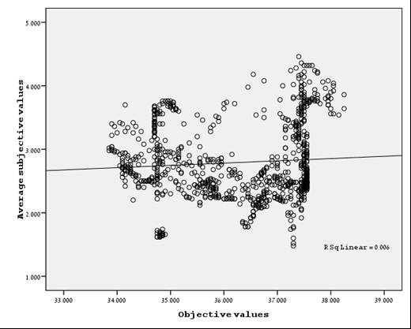
Scatterplots
PM₁₀ (X) vs. subjective estimates (Y)
SO₂ (X) vs. subjective estimates (Y)

Slide 17
Preliminary conclusions
The "objective" and "subjective" air pollution maps bear little similarity.
Notably, the neighborhoods adjacent to the city's industrial zones are perceived by survey respondents as more polluted than they actually are.
Concurrently, the heavily polluted neighborhood in the northwestern and southeastern parts of the city, relatively remote from industrial zones, are perceived by the survey respondents as having relatively clean air.

Slide 18
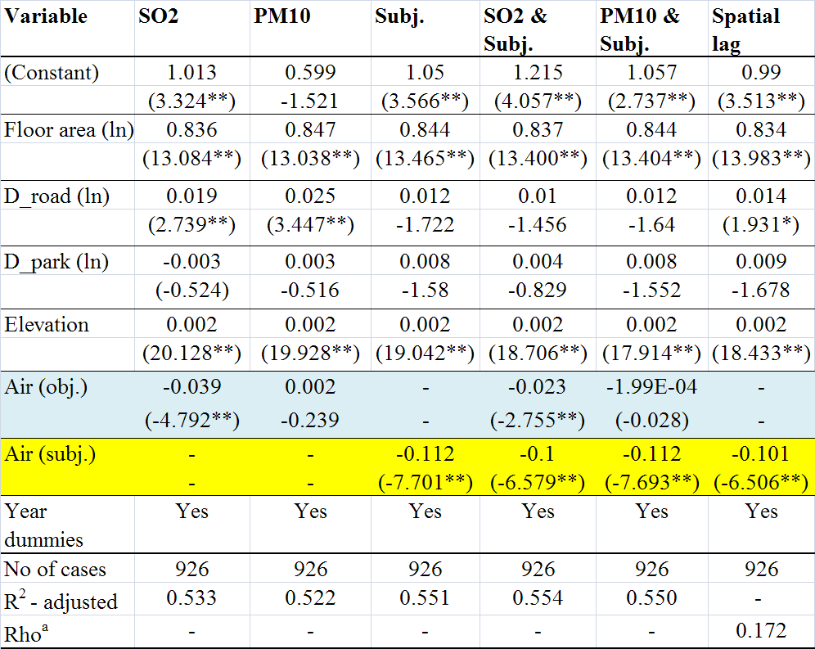
Regression models

Slide 19
Simulation test of apartment price change to plausible changes in air pollution

Slide 20
Conclusions (1)
There appears to be no strong association between objective air pollution measurements and subjective air pollution estimates;
Subjective estimates of air pollution are found to be consistently higher in close proximity to industrial areas, and in neighborhoods located on low elevations.
Neighborhoods located near parks and open areas are air quality "winners" according to the poll respondents, which is not always the case, when objective air pollution measurements are used.

Slide 21
Conclusions (2)
As the present study indicates, housing prices in urbanized areas can better be explained by subjective evaluations rather than objective measurements.
Subjective evaluations can thus be used in real estate appraisal for improving hedonic price models, especially in computer assisted mass appraisal (CAMA) systems.
Subjective evaluations can also be helpful for planners and decision-makers, enabling them to understand better the potential effect of physical improvements (such as road construction, industrial location, etc.) on residential prices and individual welfare.

Slide 22
Conlcusions (2)
Local authorities may also find subjective evaluations useful as a guideline for their efforts to maximize the local revenue base from real estate taxation and turnover rates, and for improving the overall image of the place.

Slide 23
For more information:
Berezansky, B., Portnov B.A. and B. Barzilai, Objective vs. Perceived Air-pollution as a Factor of Housing Pricing: A Case Study of the Greater Haifa Metropolitan Area, Journal of Real Estate Literature, 2010, 18(1): 99-122 (in press).
University of Haifa Real Estate Valuation and Management Program: http://management.haifa.ac.il/index.php/component/content/article/2-info/16-mba-nadlan-program

