Slide 1
Homeownership externalities, evidence from Rotterdam
Ruben Cox, Dirk Brounen and Peter Neuteboom
ERES Annual Meeting 2010 Milan

Slide 2
U.S. Department of Housing and Urban Development
Is the ‘ American Dream’ still alive?

Slide 3
Research questions
Does homeownership create positive external effects in neighborhoods?
How do these effects materialize outside the U.S.?
Are these external effects – if any – subject to diminishing returns in increases in ownership-rates?

Slide 4
Motivation
The subprime crisis
Foreclosures reached records in 2009, since low-income households were defaulting on their mortgages (Levy, 2009; FT, 2009)
2) The academic literature
Past studies have been plagued by endogeneity problems which creates problems when trying to derive causal relationships (Haurin et al., 2003; Dietz, 2002)
So results might be rather a result of self-selection than the act of homeownership itself (Shlay, 2006)
Solutions to this problem: natural experiments such as the Moving to Opportunity Programme (Katz et al., 2001) or Individual Development Accounts (Engelhardt et al., 2010)

Slide 5
Motivation (2)
Moreover, the evidence so far is primarily U.S. based:
- Engelhardt et al. 2010: political and neighborhood involvement, maintenance in Tulsa, OK
- Hilber 2005: externality risk and ownership probability, AHS
- Harkness & Newman 2002: ownership improves children's outcomes, PSID
- Glaeser & Sacerdote 2000: influence of the building type on various social indicators, GSS U.S.
- DiPasquale & Glaeser 1999: variety of social indicators, GSS U.S.
- Green & White 1997: performance of children in school, PSID/PUMS
- Rohe & Stewart 1996: neighborhood stability (length of tenure), U.S. MSA’s
There is very limited evidence from outside U.S. (such as Holland)..:
Kleinhans et al. 2007: impact of ownership on social capital in restructured neighborhoods, Rotterdam
Van Beckhoven & Van Kempen 2003: effects of urban restructuring in Amsterdam and Utrecht
..While there are major differences between Dutch and U.S. housing markets:
Current ownership levels 68% U.S. vs. 55% Holland
Marginal income tax-rates 35% U.S. vs. 52% Holland
Holland has one of the biggest social renting sectors in Europe 75% of rental properties

Slide 6
Data and Methodology
Panel dataset for 75 neighborhoods in Rotterdam over an 8 year time frame
Panel-data regression OLS/IV with FE
Measures for external effects:
Neighborhood safety index (based on reported crimes and survey data), N = 483
Neighborhood satisfaction (based on survey data), N = 434
Participation in local elections, N = 130
Controlling for:
Ownership-rates, household income, percentage elderly people, tenure length, overoccupation-, size- and age of houses, unemployment and welfare rates, address density.

Slide 7
Results of OLS and IV estimations
Controlling for: household income, percentage elderly people, tenure length, overoccupation-,
size- and age of houses, unemployment and welfare rates, address density.
Ownership-rates are instrumented by the percentage of houses offering ≥ 4 rooms in model 4-6.
Robustness checks for multicollinearity, autoregressive behavior and autocorrelation do not
materially change the results
Notes:
Note: Results for models 1-3 are obtained using a panel fixed effect model using heteroskedasticy robust standard errors estimated by OLS . Dependent variables are the log of safety (1), satisfaction (2) and participation in local elections (3). Model 3 is estimated using a crossectional model with robust standard errors, estimated by OLS. In models 4-6 ownershiprates are instrumented by the percentage of houses that provide more than 4 rooms. The dependent variable is the log of safety (1), satisfaction (2) and participation in local elections (3). Model 3 is estimated using a crosssectional IV-model. Standard errors in parentheses. Significance: *** p<0.01, ** p<0.05, * p<0.1
Non significance for voting is consistent with Engelhardt (2010)

Slide 8
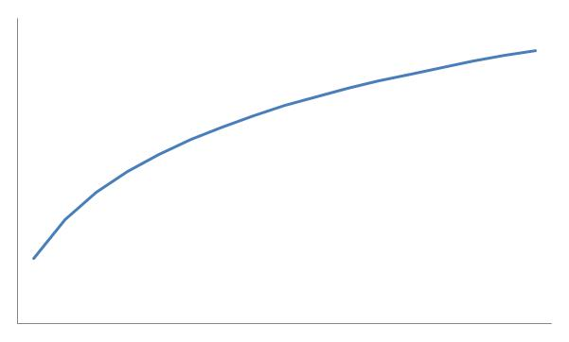
Non-linear effects of homeownership: a model
Engelhardt et al., 2010; Haurin et al., 2003, Galster et al, 2000 hypothesize a non-linear relationship between ownership rates and external effects
We hypothesize that this effect is diminishing when homeownership-rates become larger: that is the marginal increase in external effects is becoming smaller as ownership-rates become larger
Consider the following model:
Y = AKª where;
Y denotes level of external effects
A is a constant
K denotes ownership-rates
a is elasticity
This function is increasing and concave when A, K > 0 and 0 < a < 1

Slide 9
Multivariate results
Rewriting the model:
Ln(Y) = Ln(A) + aLn(K) + ε with ε IID(0,σ²)
We estimate this model twice:
Once with the original log ownership-rates (panel A)
Once with the fitted values of a regression of ownership rates on all controls (panel B)
Estimated coefficients in panel B are almost twice as large
The function is indeed increasing and concave since 0 <a < 1 and A > 0 is satisfied
Notes:
Results of A suffer omitted variable bias so results are inconsistent
Fitted values in B are assumed to be uncorrelated with the error term of the model
Effects become bigger in model B

Slide 10
Marginal analysis of the impact of ownership-rates
Consider two scenario’s where
ownership increases:
Scenario 1: 10% increase to 15%
Scenario 2: 10% increase to 60%
Predicted impact on external effects:
Safety: 1.65/2.26 vs. 0.49/1.0
Satisfaction: 8.1%/1.6% vs. 16.5%/4.3%
Voting: 7.1%/1.5% vs/ 9.5%/2.2%
Marginal change decreases quite
dramatically
A case-study points that the ‘truth’ is
somewhere between the two estimates

Slide 11
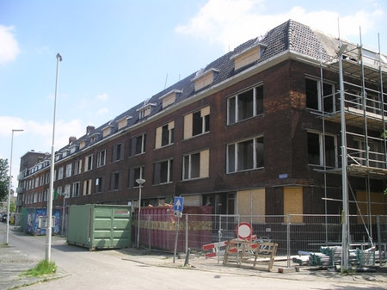
Before (and during)… After…
Case-study: Wallis-blok (pre- and post 2004) in Spangen

Slide 12
Results of the case-study: observed vs. predicted changes in external effects

Slide 13
Conclusions
Ownership-rates are related to external neighborhood effects, even when allowing ownership-rates to be endogenous.
The differences in institutional context between U.S. and the Netherlands are not directly influencing the way external effects materialize.
We find a increasing concave relationship between ownership-rates and external effects, indicating that increases in ownership-rates creates diminishing returns in external effects.
The marginal increase in external effects is already very small once ownership-rates reach levels around 55 percent.

Slide 14
Thank you for your attention!

