Slide 1
Making forecasts more holistic –defining a framework for risk analysis
Bob Thompson, RETRI Group
Sotiris Tsolacos, PPR

Slide 2
Boom times

Slide 3
Autumn economic forecasts 2006-2008: solid growth and unemployment and deficits falling
EU press release 6/11/2006

Slide 4
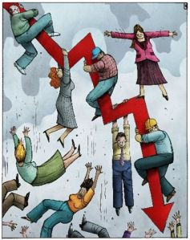
But then………

Slide 5
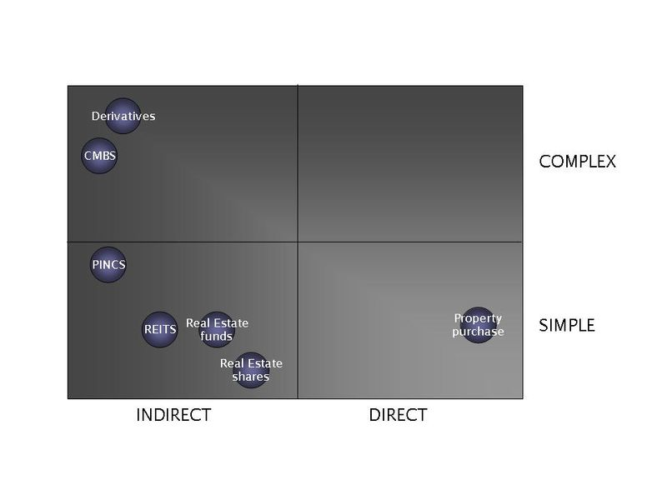

Slide 6
Risk assessment
Market risk
Indirect
Direct
Asset specific risk
Indirect
Direct
Market Actors
Rating agencies
Market Actors
Rating agencies

Slide 7
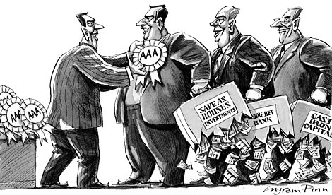
Time to rein in the rating agencies
S.E.C. Criticizes Ratings Agencies’ Conflicts of Interest
The great credit rating scandal
Brussels to reveal rating agency plans
Banks’ links with rating agencies probed
Senators accuse rating agencies of conflicts of interest in market turmoil

Slide 8
Forecasts
Model-based projection
Future demand proxy
Supply data
Estimate of future supply
Demand data
Returns data
Implied market risk
Judgement
FORECAST

Slide 9
What can the fund manager do with a forecast?
Use it to wow the investment committee
File it away
Use it as one input to further analysis of the asset/ portfolio
If things turn out well he is a genius, if things go badly the forecaster can be blamed
The investment decision has already been taken over lunch
Explore different market risk scenarios and make a more rounded decision

Slide 10
We need a model that:
Takes forecasts as inputs
Treats market risk objectively
Applies judgement in a structured and explicit way
Removes the influence of any optimism bias

Slide 11
PESTLE risk framework
Forecast
Political
Economic
Social
Technological
Legislative
Environmental

Slide 12
Model
Balanced scorecard
Consultation on structural weights
Potential for crowdsourcing of time weights

Slide 13
Summary
Lessons from the recession :
Market risk is real
Outsourcing the analysis doesn’t solve the problem
Structured, documented, holistic analysis is required
Work in progress – next step build the model!

