Slide 1
Macro Measurement and Valuation of the Building Stock
ERES 2010 Milan June, 23-25
Jo P. Soeter
Delft University of Technology
Real Estate & Housing
Building Economics

Slide 2
Content
Macro Valuation
Capital Formation and Depreciation
Expansion and Renewal
Development of Building Stock
From Analysis to Forecasting
Sectoral Capital Formation
Measurement of Building Stock
Regional Allocation of Property and Employment

Slide 3
Macro Valuation of non-residential Building Stock
Traditional approach:
Initial Building Stock
+
Cumulated Gross Fixed Capital Formation
-
Depreciation
=
Building Stock per ultimo (in euro’s)

Slide 4
Recent approach Dutch Statistics
(based upon OECD-recommendations)
Gross Fixed Capital Formation
=
Initial Stock ultimo 1969
+
Gross Capital Formation 1969-20...

Slide 5
Depreciation is split in 3 components
Disinvestment at the end of the lifetime > Gross Fixed Capital Stock
Loss of productivity during the lifetime > Productive Fixed Capital Stock
Loss of market value during the lifetime > Net Fixed Capital Stock

Slide 6
Scientific and planning problem
Related to Building Stock
Depreciation ≠ Investment for Renewal
Net investment ≠ Investment for Expansion
Alternative macro approach
Investment for Expansion = f(∆GDP)
Investment for Renewal = f(building stock)

Slide 7
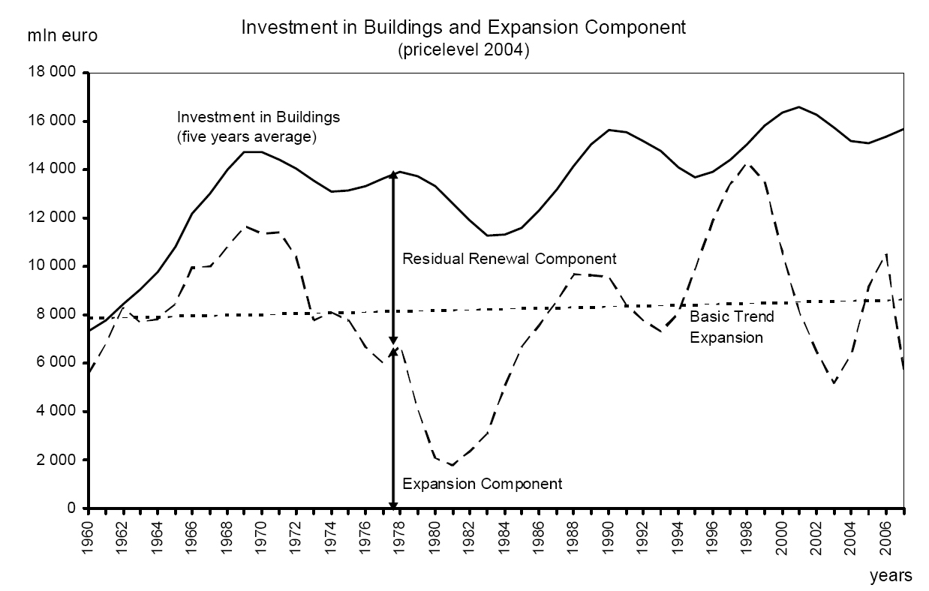

Slide 9
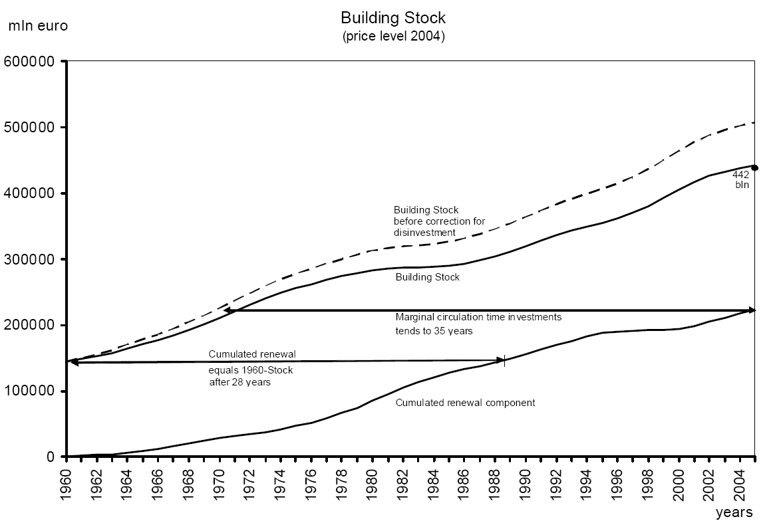

Slide 10
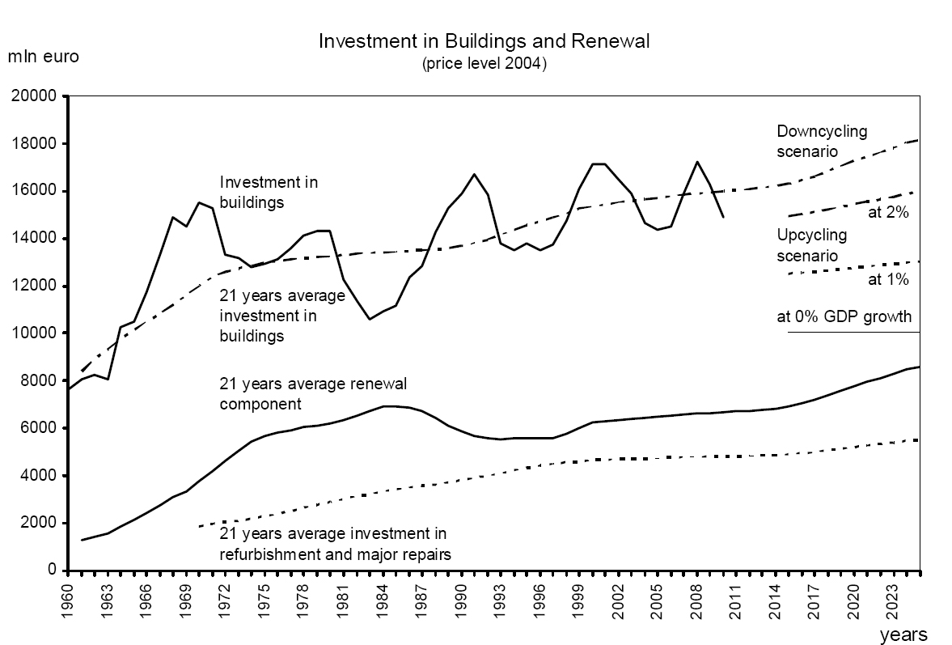

Slide 11
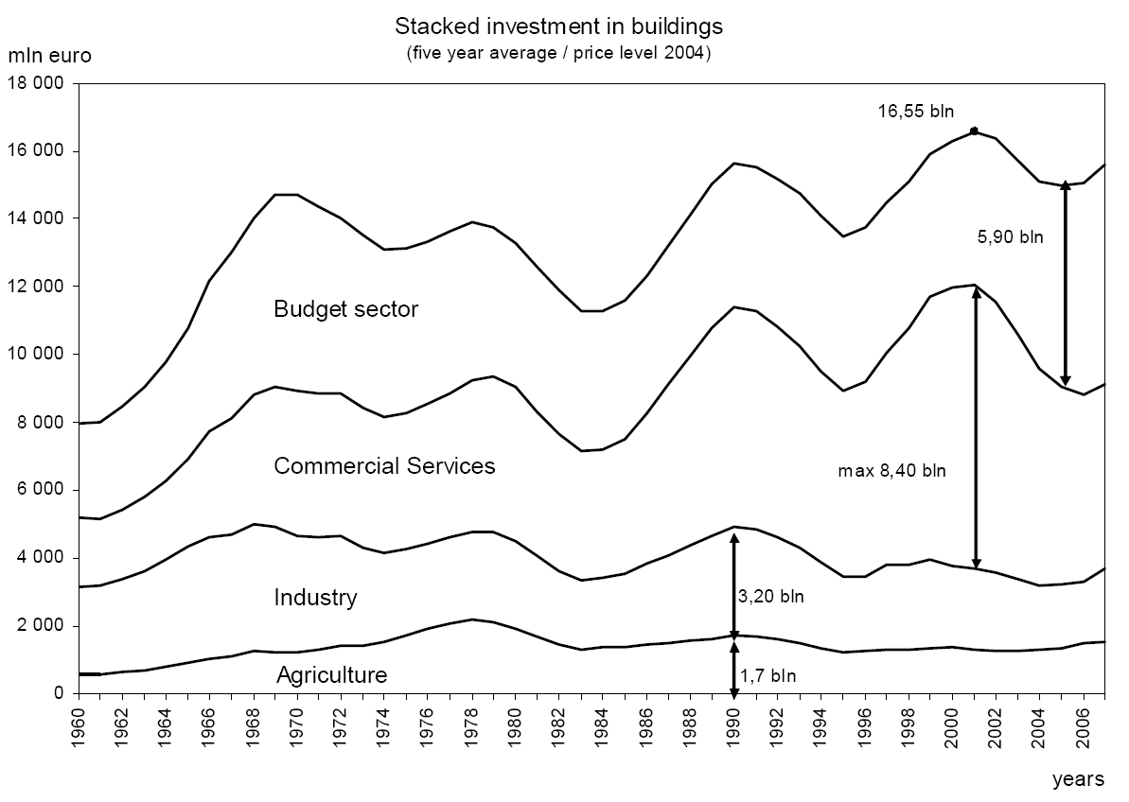

Slide 12
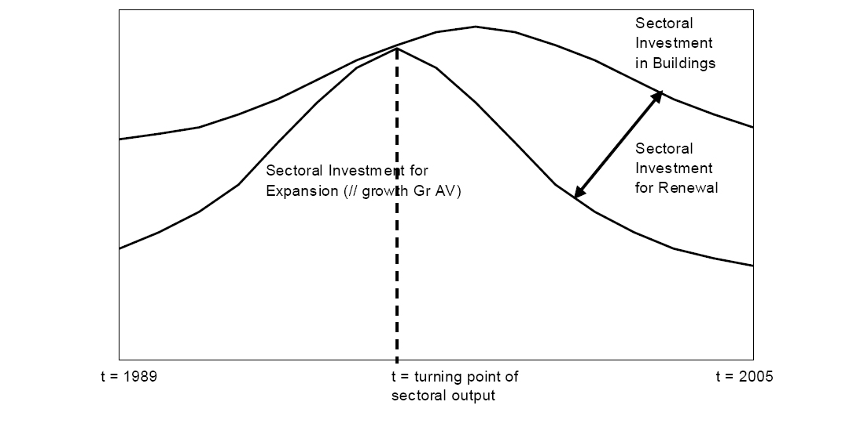
Determination sectoral expansion component

Slide 13
Measurement and Validation indicators for the Building Stock
Measurement based on physical characteristics
Valuation based on market prices
Valuation based on replacement value
Measurement based on accommodating capacity and/or in use

Slide 15
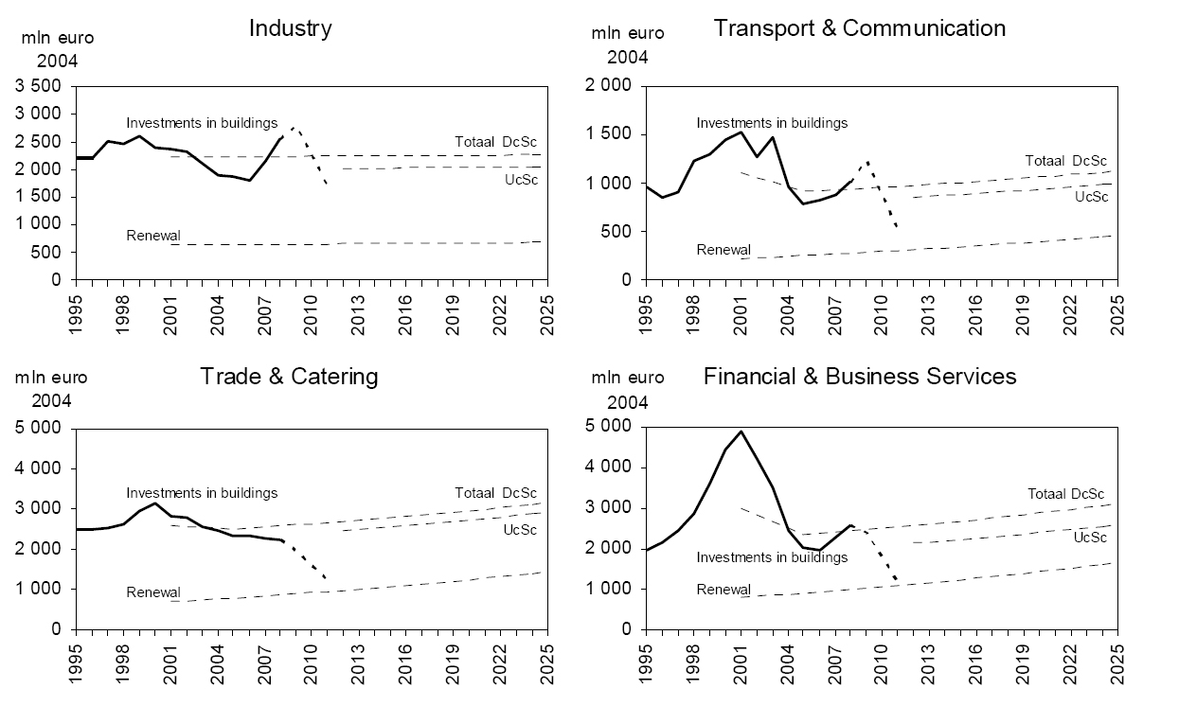

Slide 16
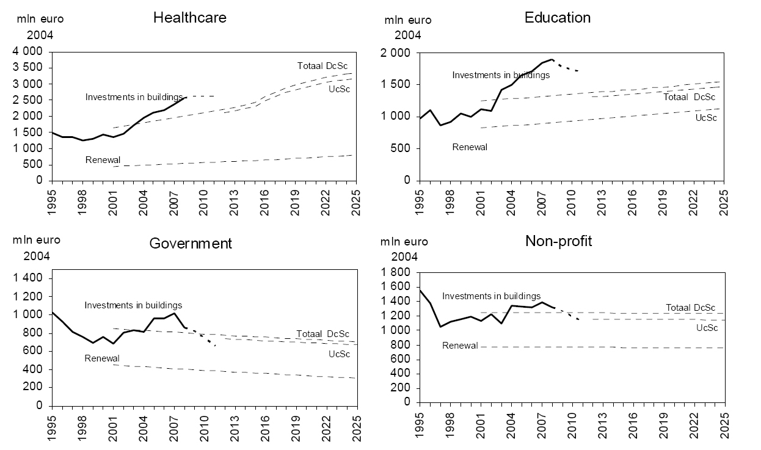

Slide 17
Stock in use 2005 535 mln m²
Available Stock 2005 circa 600 mln m²
Vacancy and underutilisation circa 100 mln m²

Slide 18
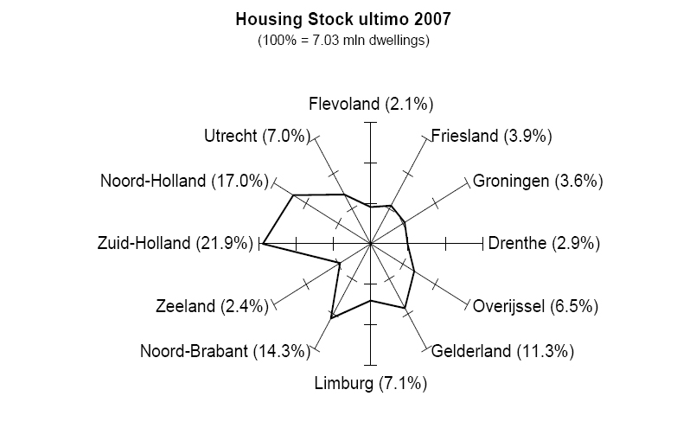

Slide 19
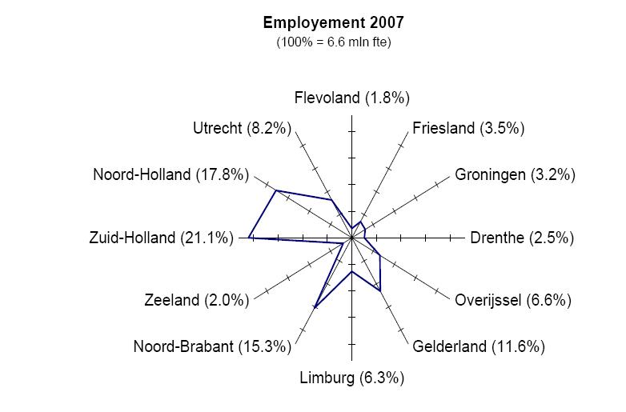

Slide 20
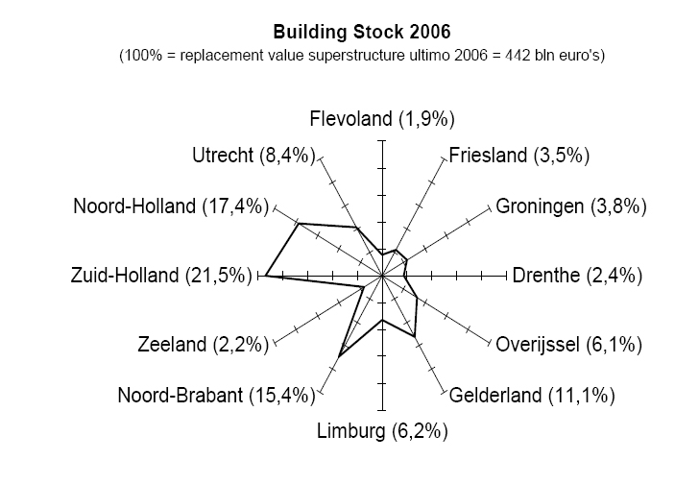

Slide 21
Conclusion (1)
After 2000
growing vacancy and underutilisation of building stock
Recovery of fixed capital formation in buildings after 2005 (favourable financial conditions, economic growth and higher public building activity)
2010-2025
Lower trend (based on Upcycling Scenario with max 2% GDP-growth, a more sustainable oriented building activity, more refurbishment and less disinvestment)

Slide 22
Conclusion (2)
Flow-stock-trend analysis offers an acceptable base for macro valuation of the stock of buildings and for scenario-linked forecasting of the trend of the sectoral building activity. It compensates the lack of integral statistic observation, measurement and valuation of the non-residential building stock.

