Slide 1
SUSTAINABLE FARMERS MARKETS IN AUSTRALIA & NEW ZEALAND
Dr Geoff Page
17th European Real Estate Society Conference
Milan, Italy, June 2010

Slide 3
Introduction
Farmers markets consumers
Market constitution
Market rules
Sustainable model
Site selection
Market mix
Market layout
Market manager
Authenticity of produce
Market promotion
conclusion

Slide 4
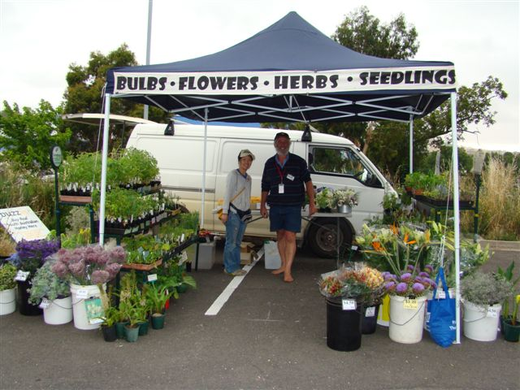

Slide 5
Introduction
Growing rapidly
Australia 120 +, USA 3000+,UK 500+,NZ 50
A predominantly fresh food market that operates regularly within a community , at a focal public location that provides a suitable environment for farmers and food producers to sell farm originated and associated value added processed foods direct to customers

Slide 6
Farmers market consumers
Foodies
Mature woman
Those concerned with power of supermarkets
Those concerned with sustainability-food miles-organic or biodynamic or IPM
Been a bit upmarket in Australia but some of United States markets accept food stamps

Slide 7
10 reasons to shop at your Farmers' Market
1. Know where your food comes from. 2. Connect with the seasons through flavourful fresh produce 3. Support local farmers and artisan producers 4. Help promote responsible land use and preserve our cultural heritage 5. Do the environment a favour, reduce food miles 6. Enjoy the regional bounty brought to you with love and care 7. Contribute to the local economy 8. Give your body a hug with healthy food – and the occasional treat 9. Get to know the best farmers, growers and food makers in the Waikato 10. Meet friends, enjoy the music and market fanfare

Slide 8
Important measures of positive influences

Slide 9
Importance of negative influences

Slide 10
Market constitution
Community not for profits
Farmers, value adders & community
Objectives to promote sustainability, education of consumers, promote diversity, promote community
Committee should have range of skills & ability to co-opt skills
Should contain very little regulation as constitutions are hard to change

Slide 11
Market rules
Where the regulations are
Time of operation, membership, stallholder rules and responsibilities, fees, complaint processors and natural justice procedures
Market rules are similar to lease conditions
Provide licence to trade, generally only for 12 months and not transferable

Slide 12
Private farmers markets
None in New Zealand
A few in Australia
In USA- Washington - Bernice Prince runs many with a turnover of $7.5m

Slide 13
Sustainable model
Markets often run by volunteers that burn out
Sensible rents-not charity rents
Membership model provides another source of revenue, 2000 ASFM, 1700 WFM, 500 VHFM & 550 at AHFM
Membership fee –from $40 to $60
10 % discount to members-built into pricing
Sponsorship – from government & business wanting to promote, green, community & healthy life styles
Government grants-eg KIK

Slide 14
New Zealand
Does not have membership model
Has several markets around Auckland that are 25-30 stalls
This means basically uneconomical to employ staff

Slide 15
stall fee(35) Stall fee (40)
Site $7.14 $6.25
market manager 36.00 31.50
other site costs 3.60 3.75
workcover 1.00 1.00
office rent 3.43 3.00
office supplies 1.57 1.38
travel/parking 2.74 2.40
accoutant/insurance 3.43 3.00
committee development 2.06 1.80
incidentals 1.42 1.25
Events 8.57 7.50
market infrastructure 9.42 8.25
promotion 8.68 7.62
cost per site 89.06 78.70
Sponsorship 14.85 13.00
grants 5.71 5.00
membership-600 16.15 13.00
$ 36.71 $ 31.00
rent to charge $ 52.35 $46.70

Slide 16
Site selection
Central community location
Good visibility
Traffic flow
Parking access
all weather options
Room for expansion
Infrastructure of power & water
Toilets
Disability considerations
Good spots for coffee & eating in all weather

Slide 17
Market mix
Will change with seasons
Need most of peoples food needs that still meet market rules requirements
What is local ?
Selection criteria-points system based on freshness, sustainable farming practices & proximity to market
Value adders need as much as possible local ingredients
Problem –if only approve part of product range

Slide 18
Market layout
Proximity to power & water
Location with respect of sun or shade
Vehicles that are required onsite-refrigeration, bulky produce
Potential research options

Slide 19
Market manager
Significant role-especially so volunteers only required for small bits
Functions include stallholder recruitment & approvals stall holder audits, production of seasonal calendar, stallholder & member communication, market promotion, finance management, member recruitment & market day set-up & close down.
Market performance statistics
Suit property graduate or tourism & event management graduate

Slide 20
Authenticity of produce
What separates a farmers market from others-need to protect the brand
Difficult & expensive-need to understand production
Concept of authentic market-USA, NZ, Vic
Push pull problems lead to cheating
Sustainable practice accreditation

Slide 21
New Zealand
Authentic Farmers Market
Certified local producer
certified local stallholder –cover local person processing product not grown in region- flour for bread, coffee

Slide 22
Australia
Concerned with production authentication-not production methods-recent problems in UK where one livestock producer was extremely bad-not good for image
Victoria has started auditing of stalls- some resistance at first
Other states do not have state organisation-but working on it.
In S.A.- each market doing its own checking with various degrees of vigour

Slide 23
Earth Market Milan
May use concept of guest stall to allow produce in-at Milan Earth market had guest stall from Sicily
Slow food movement sign off initially on providence , etc but no follow up audits

Slide 24
Market promotion
Lots of media stories-rather than lots of advertisements
Linked to market or stallholders-see next few slides as examples
Market signage

Slide 25
KIK

Slide 26
Market promotion

Slide 27
How to get farmers to grow for farmers market
Issue of producing vegetables & lesser extent fruit
Reverse the trend of large food miles, all varieties available 24/7
large producers who do not want to get involved as too much effort-we have some mid sized producers just supplying markets
Lost skills
Milan is hoping to feed Milan by 2015 in time for conference of feeding people , using less energy & treading light on planet.

Slide 28
Future & current research
Market layout in not for profit context
Market mix in not for profit context
How to get farmers to grow for farmers market

Slide 29
questions

